Slide 1

Car Price Prediction
Submitted By-: IMRAN AHMAD

Slide 2
Problem Statement
With the covid 19 impact in the market, we have seen lot of changes in the car market. Now some cars are in demand hence making them costly and some are not in demand hence cheaper. One of our clients works with small traders, who sell used cars. With the change in market due to covid 19 impact, our client is facing problems with their previous car price valuation machine learning models. So, they are looking for new machine learning models from new data. We have to make car price valuation model.

Slide 3
Exploratory Data Analysis and Preprocessing
Firstly scraped the data from various platforms like olx, cars24, droom.com etc. using selenium.
Checked for the null values in the dataset and imputed the null values.
Checked the datatype of each column for ML purpose.
Removed the unnecessary information from the columns like rupee symbol, commas etc.
Checked the shape of the dataset.
Removed unnecessary noise from the dataset like there were values like 1st and first in owners column, converted them into one value.
Removed noise from manufacturing year column too.
Encoded the string datatypes, using label encoder.
Changes the datatype of price and driven column in float datatype.

Slide 4
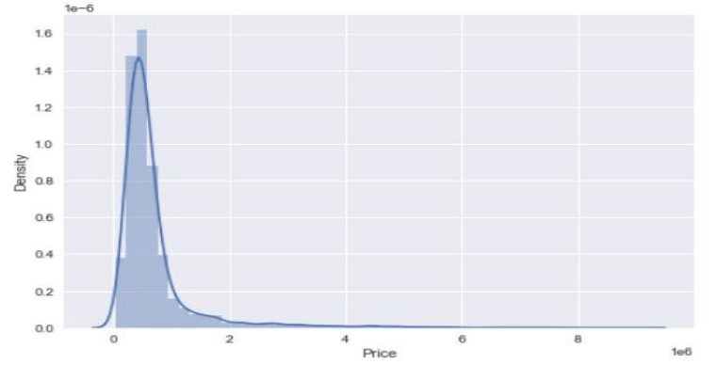
Visualization
This graph shows us that more the car is driven, the price of the car is less. As the car gets more used, it gets old and probably the parts of the car gets old and used, hence the price gets reduced.

Slide 5
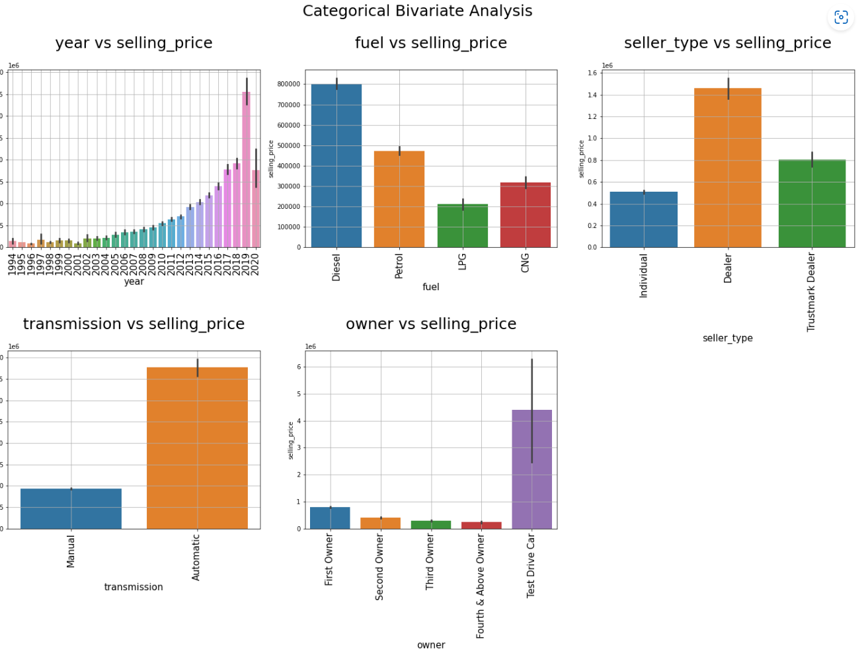
The countplot of the fuel shows that, diesel cars are more on resell than the other fuels, next count of petrol fuel is high on number.

Slide 6
Removal of outliers
We checked for the outliers present in the dataset with the help of z-score method.
After removing the outliers we checked for the data loss.
The data loss is of 6% which can be managed.
So we decided to remove the outliers and build our ML algorithm.

Slide 7
Scaling
After seeing the dataset the scales of every column had a huge difference so we needed to scale the dataset.
We used standard scaler method to scale the dataset.
Therefore, it makes mean = 0 and scales the data to unit variance.

Slide 8
Building Model
We used several algorithm to test the model: -
Random Forest Regressor.
Decision Tree Regressor.
Ada Boost Regressor.
Gradient Boosting Regressor.
Support vector Regressor.
Lasso
Ridge
Linear Regression

Slide 9
Out of all the algorithms, random forest regressor is the best performing model.
We checked different metrics to decide on our best model such as r2 score, mean absolute error, mean absolute score.
In every metric random forest performed well with the r2 score of 75%

Slide 10
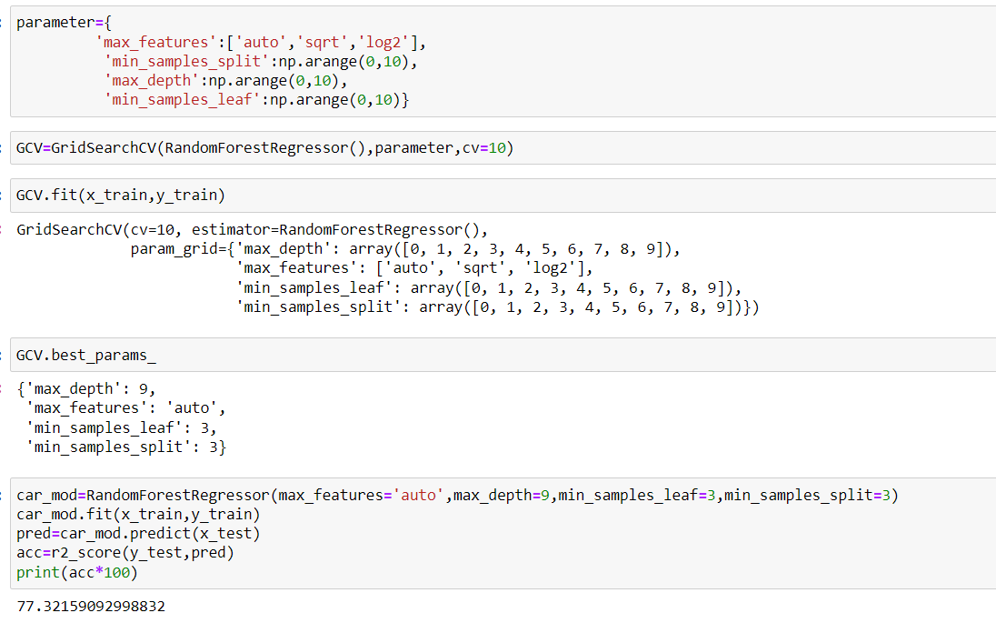
Hyperparameter Tuning
After choosing the best model, we decided to do hyperparameter tuning of the model by choosing parameters.
After getting the result of best parameter we ran the model once again and gave us the r2 score of 78%.

Slide 11
Conclusion
The purpose of this article was twofold: to understand the pattern of used cars market and make predictive model, which is able to effectively predict the price of used cars.
We use many algorithms to find best model and best result were observed of the random forest regressor with 78% r2 score accuracy with good mean absolute error.
There are many variables important to predict the price of houses. Like driven kilometres, car model, fuel of car etc.
By using machine learning model our client can decide whether to increase or decrease the price of used cars.

